Slide 1


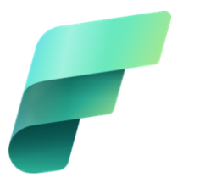
AIOps implementation (AI Assisted incident handling using Knowledge Fabric)
Team Members
Vignesh G
Aishwarya B
Darshana C R
Tharun Eshwar S
Vijay Kumar M
Mentors
Swapna Kashalkar
Archana V Pawar

Slide 2
INTRODUCTION
AIOps (Artificial Intelligence for IT Operations) uses AI and machine learning to enhance IT operations, reducing manual effort and improving efficiency
IT support teams use platforms like ServiceNow to manage the entire lifecycle of incident tickets from creation to resolution
Our solution uses Microsoft Fabric to analyze historical incident data and suggest resolution steps via Copilot, enabling faster, smarter handling and future automation

Slide 3
PROBLEM STATEMENT
Manual Incident Classification and Resolution
NO Automated Knowledge Recommendations. Traditional knowledge bases are static
Inconsistent user experience
Slower Ticket Resolution Time
Heavier workload for support team

Slide 4
OBJECTIVES
Implement an AIOps framework using Microsoft Fabric to detect, analyze, and recommend resolutions for IT incidents
Empower IT teams with a self-service tool for actionable insights, reducing manual troubleshooting and accelerating resolution
Enhance reliability by minimizing downtime, lowering MTTR, and enabling proactive incident handling

Slide 5
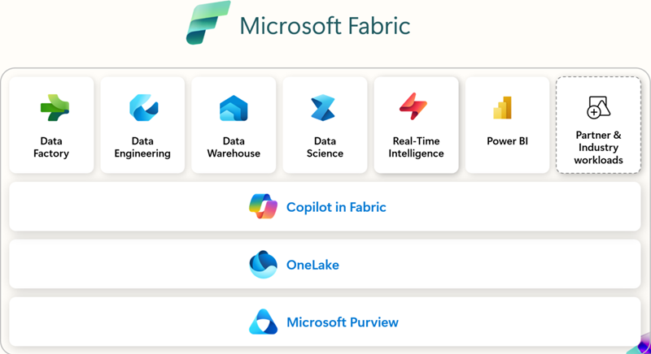
OVERVIEW – MS FABRIC
Microsoft Fabric is a unified, AI-powered platform that manages the entire data lifecycle — from ingestion to insights—in one place
A one-stop solution for
Storing,
Cleaning,
Analyzing and
visualizing data
through dashboards and reports

Slide 6
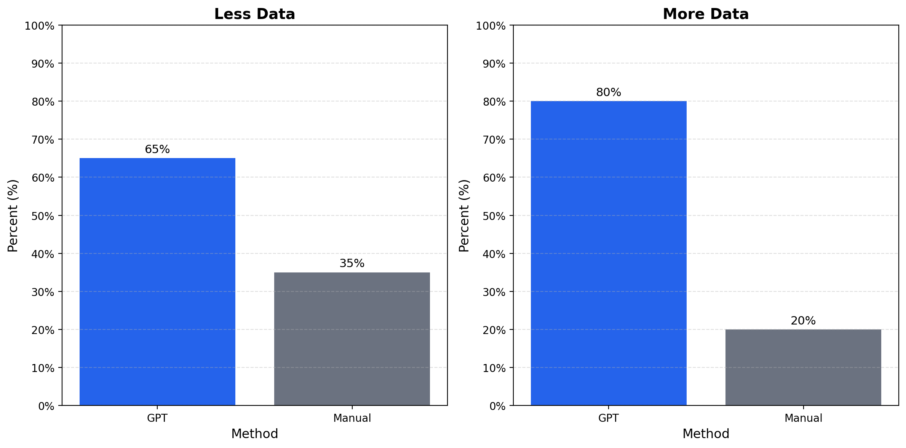
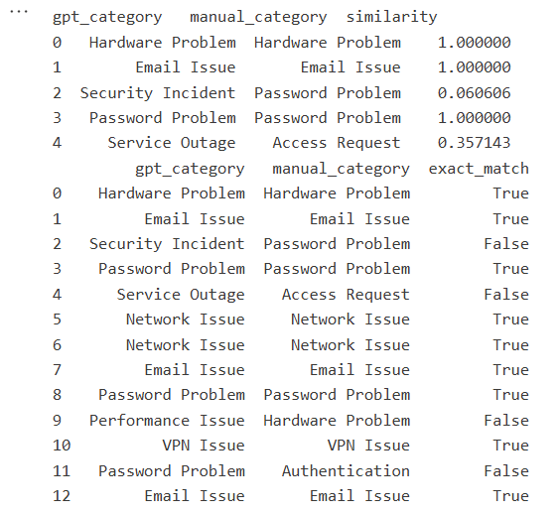
COMPARATIVE STUDY

Slide 7
IMPLEMENTATION STEP
Workspace & Data: Create workspace and load incident data into Lakehouse for centralized storage
Pipeline & Ingestion: Build pipeline to automate data movement from source to Lakehouse
Preprocessing: Use Notebook for cleaning, transforming, and saving processed data into tables
Reporting & Insights: Generate Power BI dashboards and leverage Copilot for insights

Slide 8
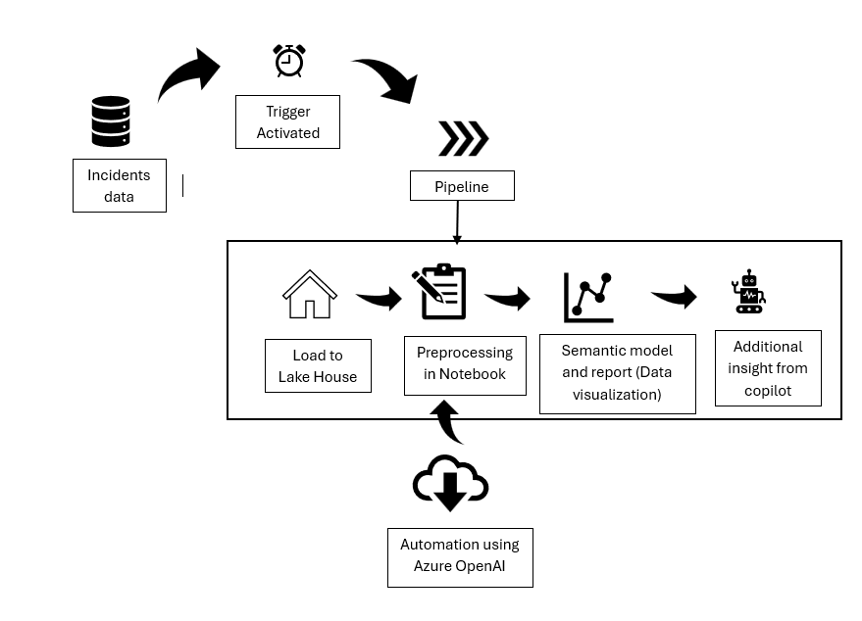

ARCHITECTURE DIAGRAM

Slide 9
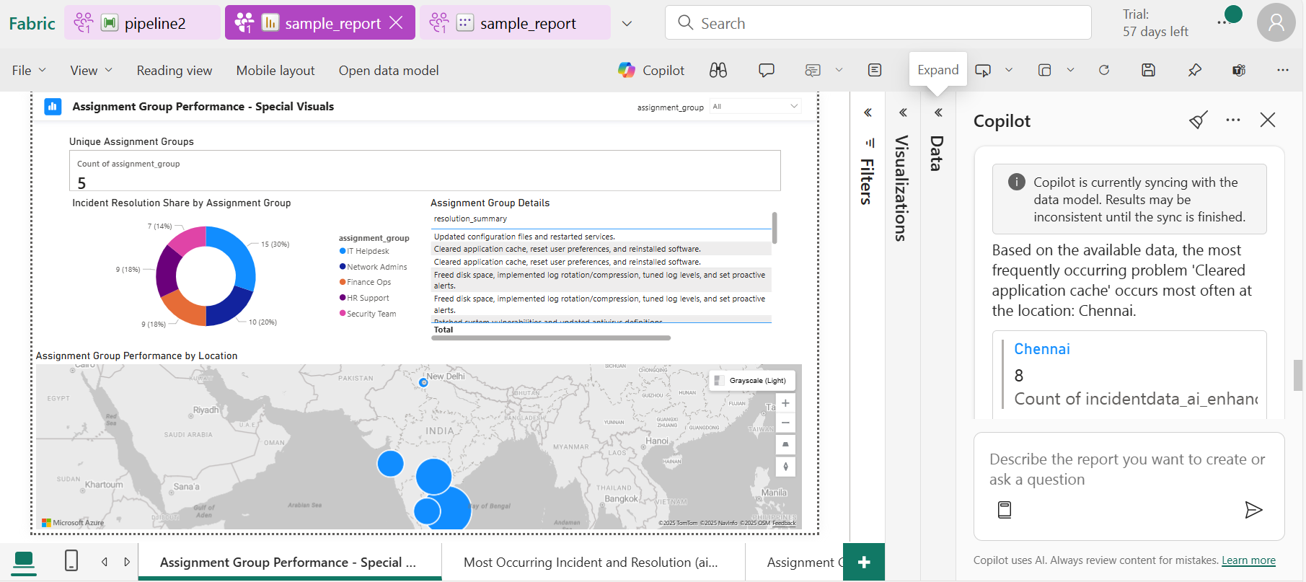
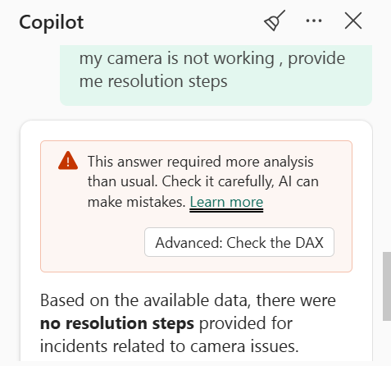
OUTPUT

Slide 10
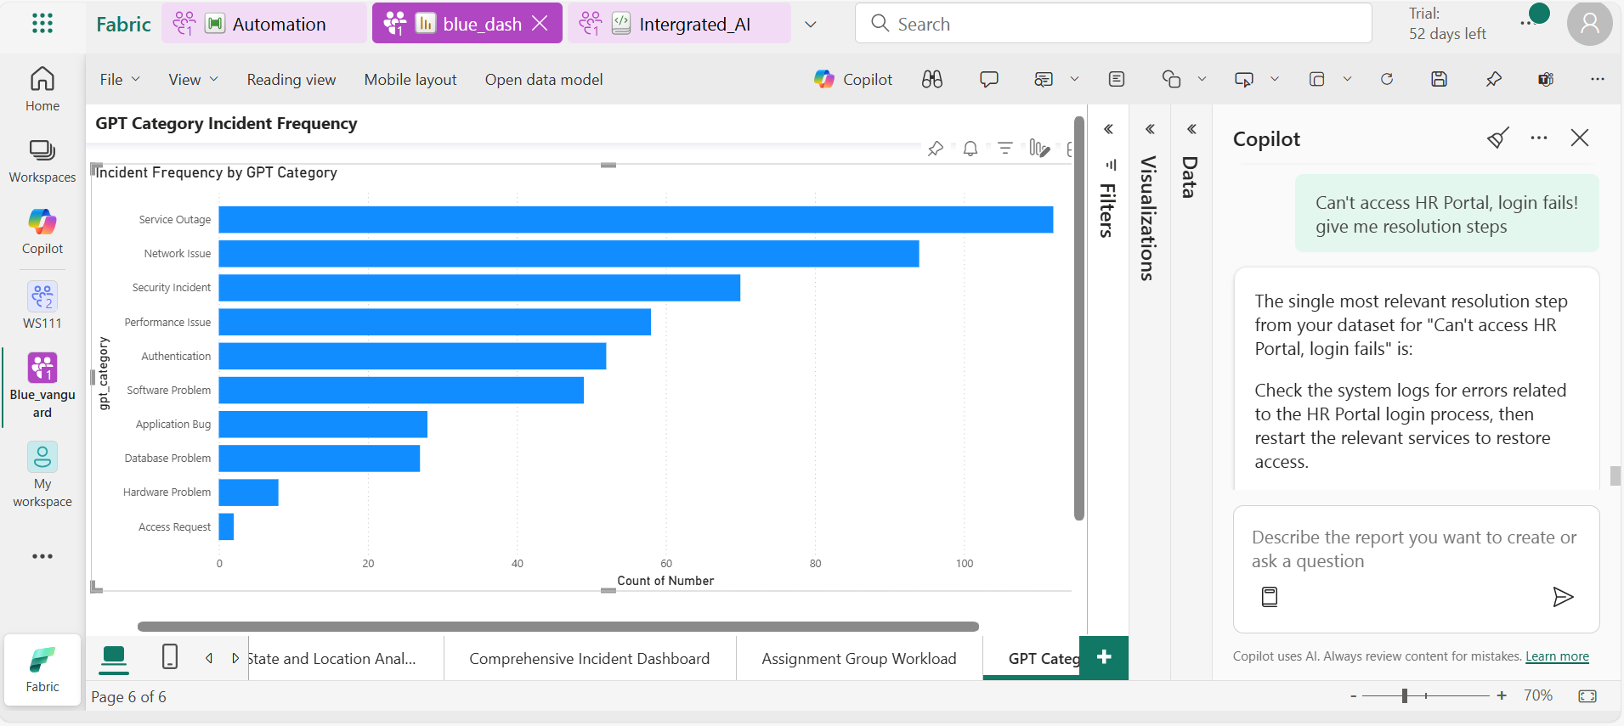
OUTPUT - resolution step

Slide 11
OUTCOMES
Intelligent Incident Handling: Automated pipelines ingest and
process incident data with minimal manual effort
Real-Time Insights: Power BI and Copilot deliver live analytics
and intuitive natural language access
Flexible Architecture: Microsoft Fabric ensures unified data
management with adaptive learning for growth and
customization

Slide 12
FUTURE ENHANCEMENT
Interactive User Interface with Natural Language Processing (Azure AI Foundry - Chatbot)
Integration with Service Now and work with the live data.
Intelligent Routing and Auto Assignment if issue is unresolved

Slide 13
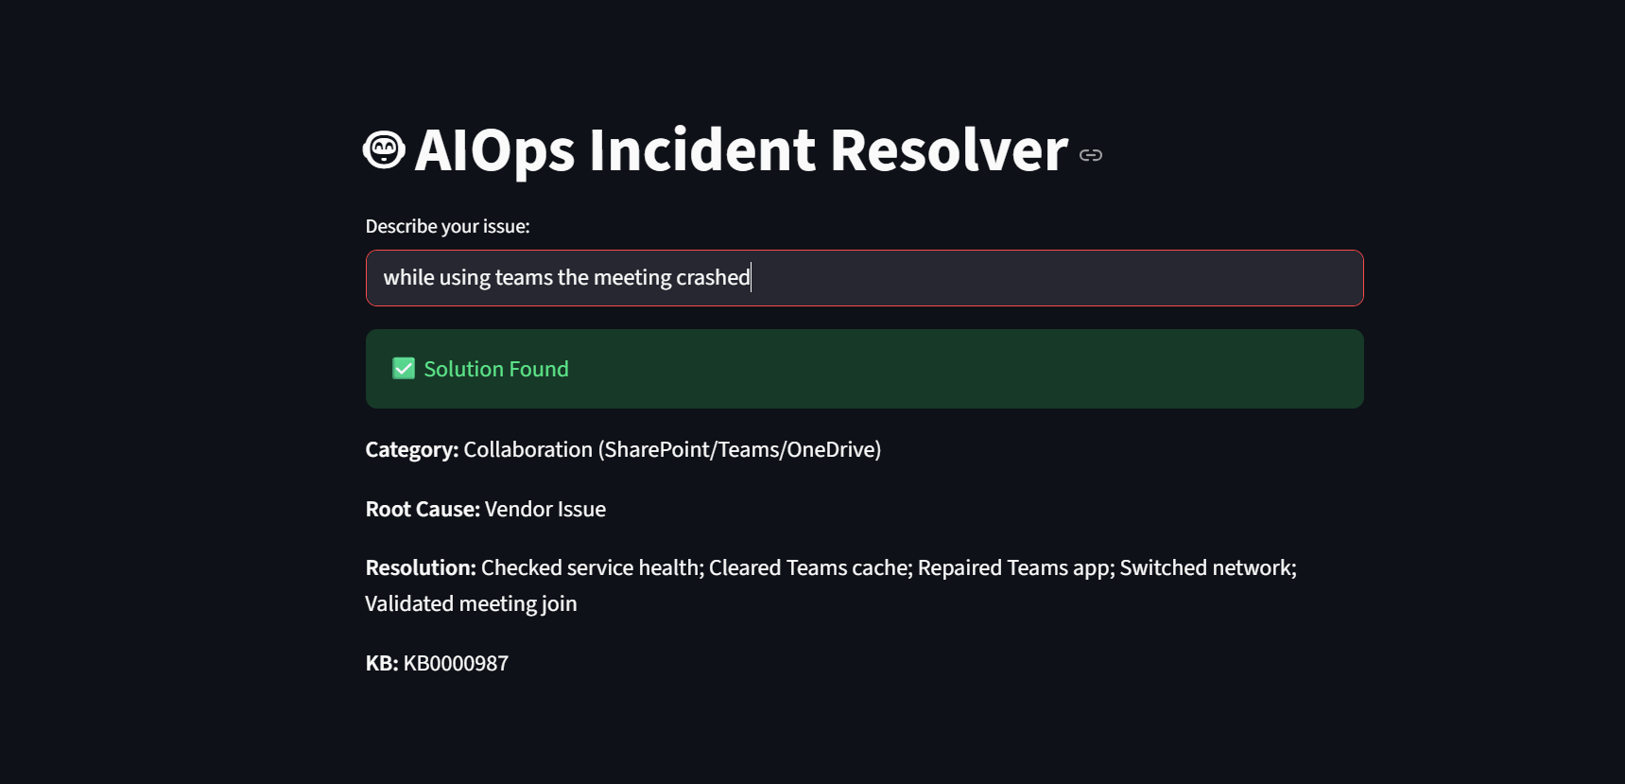
DEMO MODEL

Slide 14
CONCLUSION
Leverages Microsoft Fabric for unified data management and real-time insights
Provides resolution steps via Copilot based on analyzed incident data for smarter handling
Lays the foundation for future automation and scalable growth, creating a smarter, faster IT ecosystem

Slide 15
THANK YOU !

